Slide 1
Introduction to Reverse Mortgages FOR THE CONSUMER
UNIVERSITY MORTGAGE CORPORATION

Slide 2
Topics
What is a Reverse Mortgage?
Advantages
Eligibility
Consumer Protections
Things to Consider
Frequently Asked Questions

Slide 3
What is a Reverse Mortgage?
A loan for seniors age 62 and older
Converts a portion of home equity into cash with no monthly mortgage payments*
Majority of reverse mortgages are HECMs (Home Equity Conversion Mortgage, a federally insured program)
*Taxes and insurance must still be paid on time. Any costs to keep up property maintenance must still be paid. Failing to meet these requirements can lead to default.

Slide 4
How Does it Work?
You must live in home as your principal residence.
No repayment of the mortgage is required until you permanently move out, sell the home, or pass away.
You are required to continue paying property taxes and insurance and maintain the home according to FHA guidelines.

Slide 5
Advantages
No monthly mortgage payments*
Non-recourse loan – you’ll never owe more than what home is worth
Leverage crucial retirement cash liquidity
No limitations on how you use funds
No pre-pay penalty
* You must live in the home as your main residence.

Slide 6
Eligibility
Be 62 years of age or older
Own the property outright or have considerable equity
Occupy the property as your principal residence
Not be delinquent on any federal debt
Participate in a consumer information session from HUD

Slide 7
Consumer Protections
Non Borrowing Spouse (< 62) is now protected
All FHA HECM’s are insured through the Federal Housing Administration (FHA)
Borrowers have no limit as to how long they can stay in the home*
When loan becomes due, Estate can buy your home at 95% of current value, regardless of what is owed
*Taxes and insurance must still be paid on time. Any costs to keep up property maintenance must still be paid. Failing to meet these requirements can lead to default.

Slide 8
Consumer Protections (cont’d)
Education – Financial counseling is required (provided by HUD)
Safeguards
ensures the amount owed on the loan can never be more than the value of the home at the time of sale
Reverse Mortgages are Non-Recourse Loans

Slide 9
Non-Recourse Loan
The HECM is insured through FHA and is a non-recourse loan.
The homeowner or their heirs will never be asked to pay back more than the value of the home, even if the debt has grown to be greater than the value.*
*If the heirs choose to keep the home, they will need to pay off the loan at 95% of the fair market value of the home, as determined by a third-party appraiser.

Slide 10
Things to Consider
Prepare for counseling meeting
Continue keeping property taxes and homeowners insurance current
Home value, owner age(s), and current interest rate determine eligible amount to borrow

Slide 11
Frequently Asked Questions
Will I still have an estate that I can leave to my heirs?
When the loan is due, the estate will repay the cash they received from the reverse mortgage, plus interest and any other fees, to the lender. The remaining equity in the home, if any, belongs to the borrower or to their heirs.
The more you borrow and the longer you stay in the loan, the less equity your estate can typically expect to receive.
Factors that determine future equity include; future interest rate (+/-), home appreciation (+/-), consumer spending, longevity in the loan.

Slide 12
Frequently Asked Questions
When does the loan become due and payable?
A HECM loan must be repaid in full when the last remaining borrower permanently vacates the residence. The loan also becomes due and payable if:
Borrowers did not pay property taxes or hazard insurance or violate other obligations.
Borrowers permanently move to a new principal residence.
The last borrower fails to live in the home for 12 months in a row (for example, the borrower has a 12-month or longer stay in a nursing home).
The borrowers allow the property to deteriorate and do not make necessary repairs.

Slide 13
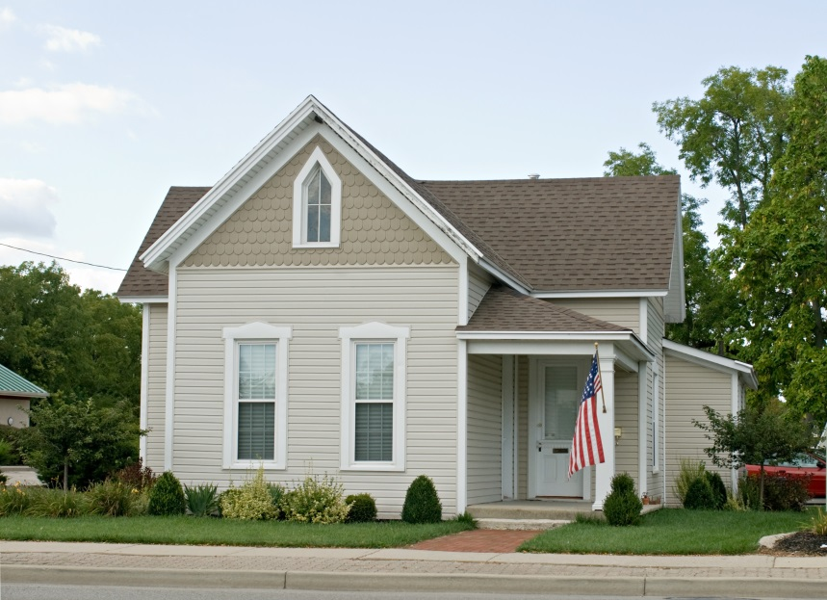
Frequently Asked Questions
Can the homeowner be forced out of their home?
The FHA reverse mortgage loan exists to help homeowners stay in their home. However, the homeowner must reside in the home as their primary residence, pay property taxes and homeowners insurance, and maintain the home. Failure to do so may require the servicer to initiate foreclosure proceedings, per HUD guidelines.

Slide 14
Additional Resources
National Council on Aging (NCOA), http://www.ncoa.org
National Reverse Mortgage Lender’s Association, http://www.reversemortgage.org

Slide 15
Thank you
Robert Cardoza, Broker
University Mortgage Corporation
(408) 410-2145
robert@universitymortgage.com
www.universitymortgage.com

